Slide 1


APEX YOUTH FOOTBALL ACADEMY
SE212 DATABASE DESIGN AND DATABASE SYSTEM
Football Academy Management System (FAMS)
Noppajit Jadsorn · 682115020
Jakkaphat Didsabanjong · 682115008
Term Project Final Report · Instructor: Aj. Pree
Notes:
Welcome. We present FAMS, the Football Academy Management System for Apex Youth Football Academy: a MySQL-backed web application. We cover the business, rules, design, implementation and a tour of the live system.

Slide 2
A YOUTH ACADEMY RUN ON SPREADSHEETS
01 · INTRODUCTION
118
8
12
4
36
Players
Coaches
Classes
Age groups
Sessions per week
The problem
The solution: FAMS
Spreadsheets, registration forms and attendance sheets risk duplicate registrations, outdated age-group assignments and slow attendance reporting.
Unique registrations, age-group eligibility checks, and attendance tied to training sessions, in one MySQL-backed web application.
Fictional academy; the figures are planning assumptions. Actors: Administrator, Coach, Parent / Guardian, Academy Manager.
Notes:
Apex is a fictional youth academy designed around 120 players, 8 coaches, 12 classes, 4 age groups and 36 sessions a week; these are planning assumptions. The manual process creates risks such as a player promoted from U12 to U16 still being linked to a U12 class (an illustrative scenario, not a verified incident). Actors: Administrator (daily), Coach (each session), Parent/Guardian (as needed), Academy Manager (weekly). Out of scope: payments, native mobile apps, multiple branches, advanced analytics, secondary positions.

Slide 3
ACCURATE LINKS BETWEEN PLAYERS, CLASSES AND ATTENDANCE
02 · MOTIVATION
100%
< 5 s
< 5 s
of duplicate registrations and attendance entries prevented in constraint tests
to generate an individual player attendance report
to produce enrollment summaries for all 12 classes
Primary and foreign keys, UNIQUE constraints and validation rules keep records consistent and verify player eligibility.
These are targets for testing, not verified results; no manual-reporting baseline is claimed.
Notes:
We chose this project because academy operations depend on accurate relationships between players, classes, coaches, registrations and attendance. These three objectives are targets for testing, not measured results.

Slide 4
26 RULES IN SEVEN AREAS
03 · BUSINESS RULES
Area | Rules | Enforced by
Players, age groups, positions | 1–6 | FKs, CHECK, subtype triggers
Coaches, programs, sessions | 7–10 | NOT NULL FKs, CHECK on times
Parents and guardians | 11–13 | Junction table, UNIQUE primary
Registration and enrollment | 14–17 | UNIQUE (player, class), trigger
Attendance | 18–21 | UNIQUE (player, session), CHECK
Age-group history | 22–23 | FKs, CHECK on date range
Integrity and reporting | 24–26 | Transaction, SQL, role-based access
Database constraints and triggers first; the Node.js/Express app adds validation and access control.
Notes:
The 26 business rules are enforced by database constraints and triggers where implemented, with extra validation and role-based access control in the Express application. Examples: a player may register for the same class only once (UNIQUE player_id, class_id); only one attendance record per player per session; a player has at most one primary guardian; class enrollment must not exceed capacity; a player must meet the class's age-group requirement.

Slide 5
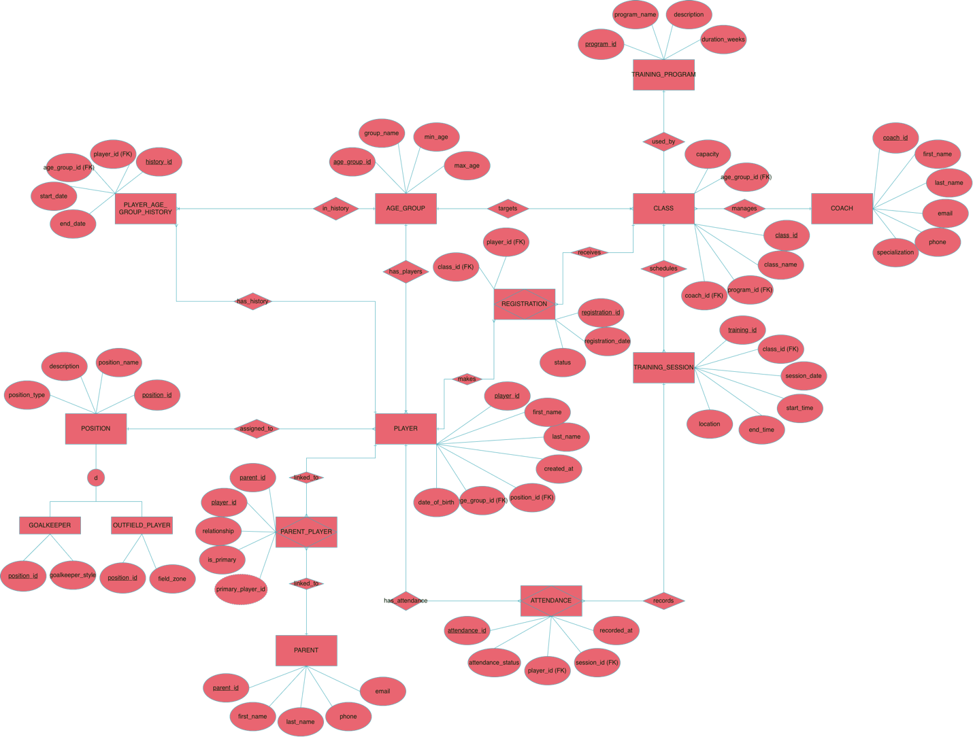
EER DIAGRAM
04 · ERD
14 core entities in Chen notation with cardinality indicators.
Associative entities: REGISTRATION, ATTENDANCE, PARENT_PLAYER.
Specialization: POSITION into GOALKEEPER or OUTFIELD_PLAYER, disjoint and total.
Figure: EER diagram of FAMS.
Notes:
Walk through the diagram: Age Group has many Players and Classes; Position has many Players and specializes into Goalkeeper and Outfield Player; Parent and Player are many-to-many through Parent_Player; Coach manages many Classes; Training Program is used by many Classes; Class schedules many Training Sessions; Player enrolls in Class through Registration; attendance is recorded through Attendance; Player_Age_Group_History keeps start and end dates.

Slide 6
14 CORE RELATIONS AND 2 SUPPORTING
04 · TABLES
Reference data
People
age_group · coach · position · goalkeeper · outfield_player · training_program
player · parent · parent_player
Operations
Supporting
class · training_session · registration · attendance · player_age_group_history
app_user (login and roles) · age_group_recommendation
Primary keys, foreign keys, UNIQUE and CHECK constraints, and triggers maintain integrity. Capacity and access rules sit in the application.
MySQL 8+ · lowercase snake_case · schema in database/01_schema.sql
Notes:
The physical schema has 14 core tables plus two supporting tables, app_user for authentication and roles and age_group_recommendation for coach recommendations. The main schema is database/01_schema.sql; other scripts add seed data, queries, authentication, features and business-rule triggers.

Slide 7
FROM THREE FORMS TO BCNF
05 · NORMALIZATION
UNF
1NF
2NF
3NF
BCNF
Three business forms: enrollment, attendance and development
Each repeating group becomes its own relation
Partial dependencies removed: guardian details move to PARENT
Transitive dependencies extracted into 14 relations
Every non-trivial determinant is a candidate key
EXAMPLE DEPENDENCY
age_group_id determines group_name, min_age, max_age, so we extract AGE_GROUP.
Constraints, triggers and application checks complement normalization; they are not normalization steps.
Notes:
We normalized three business forms step by step. 1NF separates repeating groups. 2NF removes partial dependencies such as parent_id to parent details. 3NF extracts transitive dependencies: age_group_id to group details, position_id to position details, coach_id, program_id, class_id, session_id, plus the goalkeeper and outfield subtypes. Under the stated functional dependencies each determinant is a candidate key or superkey, so the 14 core relations are designed to satisfy BCNF.

Slide 8
EER TO RELATIONAL SCHEMA
06 · MAPPING
Step | EER construct | Result
1 | Regular entities | One table per entity (7)
4 | Binary 1:N | Foreign key on the N side
5 | Binary M:N | PARENT_PLAYER, REGISTRATION, ATTENDANCE
8 | Specialization | Option 8A: superclass and subtype tables
2, 3, 6, 7, 9 | Weak, 1:1, multivalued, n-ary, union | Not required in this model
Extra | Supporting features | APP_USER, AGE_GROUP_RECOMMENDATION
WHY OPTION 8A
It mirrors the EER and keeps subtype attributes apart without NULLs. The cost is extra JOINs and validation.
Nine-step mapping algorithm (Elmasri and Navathe).
Notes:
We applied the standard nine-step mapping algorithm. Seven regular entities become tables. All 1:N relationships become a foreign key on the N side, for example class.coach_id. Three M:N relationships become associative tables. For the POSITION specialization we chose option 8A: POSITION holds position_id, position_name and position_type; GOALKEEPER holds goalkeeper_style; OUTFIELD_PLAYER holds field_zone; each subtype uses position_id as both primary and foreign key. Pros: follows the EER, avoids NULLs. Cons: JOINs and extra validation to enforce disjoint and total.

Slide 9
CONSTRAINTS THAT ENFORCE THE RULES
07 · DDL
CREATE TABLE class (
class_id INT AUTO_INCREMENT
PRIMARY KEY,
class_name VARCHAR(120) NOT NULL,
coach_id INT NOT NULL,
program_id INT NOT NULL,
age_group_id INT NOT NULL,
capacity INT NOT NULL DEFAULT 30,
/* FKs: coach, program, age group */
CHECK (capacity > 0)
);
CREATE TABLE registration (
registration_id INT AUTO_INCREMENT
PRIMARY KEY,
player_id INT NOT NULL,
class_id INT NOT NULL,
registration_date DATE NOT NULL,
status ENUM('Active','Pending',
'Cancelled','Completed')
NOT NULL DEFAULT 'Active',
UNIQUE (player_id, class_id)
/* FKs: player, class */
);
Rules 2, 7, 8: one coach, program and age group per class.
Rule 15: a player registers for a class only once.
Shortened excerpts; full DDL in database/01_schema.sql.
Notes:
CLASS stores each training class and references its coach, program and age group; capacity must be greater than zero. REGISTRATION uses a surrogate key and a UNIQUE (player_id, class_id) constraint so a player cannot register twice for the same class. Age-group eligibility and class capacity are checked by additional validation. The slide shows shortened excerpts; the real script has named constraints.

Slide 10
REGISTERING A PLAYER, ATOMICALLY
07 · DML
1
START TRANSACTION and lock the class row with SELECT ... FOR UPDATE.
async function transaction(work) {
const conn = await pool.getConnection();
try {
await conn.beginTransaction();
const result = await work(conn);
await conn.commit();
return result;
} catch (error) {
await conn.rollback();
throw error;
} finally { conn.release(); }
}
2
Count Active registrations and compare with the class capacity.
3
Check that the player's age group matches the class.
4
INSERT the registration with CURDATE() and status Active, then COMMIT, or ROLLBACK on any failure.
Transaction helper in Node.js (mysql2 connection pool); variable names shortened for the slide.
Notes:
The registration is a transaction. The class row is locked with SELECT ... FOR UPDATE, the active registration count is compared with the capacity, and the player's age group is validated. If both checks pass the registration is inserted with today's date and status Active and the transaction commits. Otherwise the app rolls back. The Node.js helper gets one connection from the pool, begins the transaction, runs the work, commits on success, rolls back on error and always releases the connection.

Slide 11
10 BUSINESS REPORTS IN PLAIN SQL
07 · SQL REPORTS
Enrollment
Attendance
Schedule
Active registrations by class, with coach, age group and capacity. LEFT JOIN, COUNT, GROUP BY.
Present, absent and late counts per player, plus attendance percentage per class.
Training sessions from today onward, with class, time, location and coach.
Other reports: players per age group and position, sessions per coach, players without an active registration, registrations by status, and age-group history.
Source: database/03_queries.sql
Notes:
03_queries.sql holds 10 business reports. In the attendance percentage reports, Present and Late count as attended while Absent and Excused do not. These reports also appear in the SQL Reports page of the application.

Slide 12
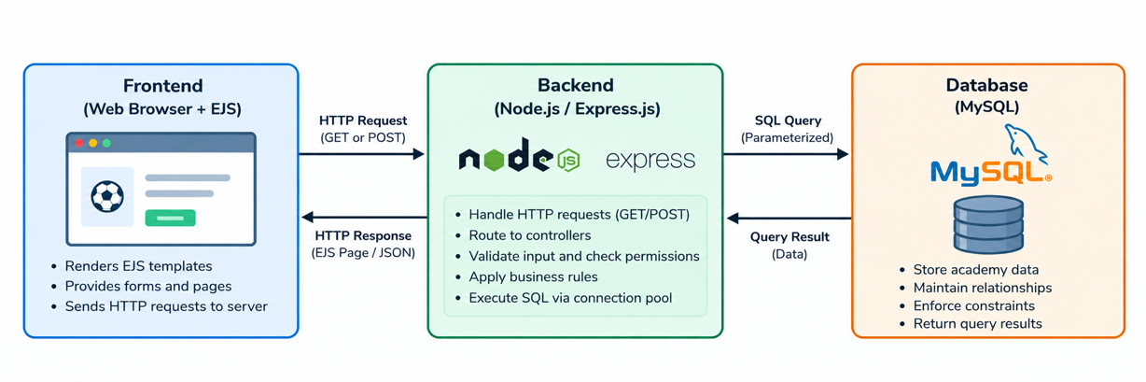
THREE-TIER WEB APPLICATION
08 · ARCHITECTURE
Browser: EJS pages and forms.
Express: routing, authentication, validation, business rules.
MySQL: relational data and integrity constraints.
The browser never talks to the database directly.
Notes:
A request flows: browser, route protection, Express routes, business logic, data access with parameterized queries, then MySQL. The browser does not communicate directly with the database.

Slide 13
TWO USERS, ONE LAST SEAT
08 · CONCURRENCY CONTROL
1
2
3
4
Scenario
Lock
Wait
Re-check
A class holds 20 players and has 19 active registrations. Two users register one more at once.
The first transaction locks the class row with SELECT ... FOR UPDATE.
The second transaction waits until the first commits.
It counts again, sees 20 of 20 and rejects the registration.
MySQL InnoDB supports transactions and row-level locking.
Prevents over-enrollment when used consistently for every registration operation.
Notes:
Concurrency control matters when multiple users register players for the same class at the same time. InnoDB row-level locking with SELECT ... FOR UPDATE serializes the capacity check so both requests cannot exceed the capacity. This protects against over-enrollment only if it is applied consistently in all registration operations.

Slide 14
NODE.JS, EXPRESS, EJS AND MYSQL
09 · TECH STACK
Layer | Technology | Version | Purpose
Database | MySQL | 8+ | Tables, transactions
DB driver | mysql2 | 3.24.5 | Pool, plain SQL
Web | Express.js | 5.2.1 | Routes, middleware
Templates | EJS | 7.0.1 | Server-side HTML
Runtime | Node.js | 18+ | Runs the server
Auth | express-session, bcryptjs | 1.19.0, 2.4.3 | Login, roles
Validation | express-validator | 7.3.2 | Input checks
Tools | Git, GitHub, VS Code | - | Code and design
Plain SQL with mysql2 and no ORM keeps joins, constraints and transactions explicit.
Notes:
MySQL gives primary and foreign keys, CHECK constraints, transactions and SQL. Node.js, Express and EJS give a straightforward three-tier app without a separate frontend framework. Plain SQL with mysql2 suits a database design project because joins, constraints and transactions are visible. Testing: Node test runner for authorization tests, database verification scripts, and manual browser testing of login, players, registration and attendance.

Slide 15
FOUR ROLES, CHECKED ON THE SERVER
10 · ROLE-BASED ACCESS
Admin
Coach
Parent
Management
Manages academy records, users, classes, registrations and attendance.
Views assigned classes, records attendance, submits age-group recommendations.
Sees linked children, schedules and attendance.
Reviews dashboards and management reports, read only.
Login sessions, bcrypt password hashing and a role check on every route, with CSRF protection in middleware.
Source: src/middleware/auth.js, csrf.js and tests/authorization.test.js
Notes:
The route middleware lets Admin do everything, Management read the dashboard, reports and profile, Coach use the coach portal, attendance and recommendations, and Parent view their own children and profile. Authorization tests live in tests/authorization.test.js.

Slide 16
SIX MILESTONES, DELIVERED
11 · MILESTONES
Week | Milestone | Owner | Date
Pitch | Proposal and 4-slide pitch | Whole team | 1 Sep 2026
4 | EER diagram | Noppajit | Early Sep 2026
6 | Schema and 3NF/BCNF | Noppajit | 26-30 Sep 2026
7 | Database built and seeded | Jakkaphat | Sep 2026
8 | SQL queries and reports | Jakkaphat | 5-6 Oct 2026
9 | Web app, demo, final report | Whole team | Oct 2026
Dates from our design documents and Git history.
Notes:
Pitch: proposal, objectives, scope, user roles, 25 business rules and a preliminary EER. Week 4: EER diagram in Draw.io. Week 6: relational schema, normalization and mapping. Week 7: MySQL schema, DDL, sample data. Week 8: SQL query scripts, at least 10 queries. Week 9: Node.js/Express application with EJS, role-based access, documentation, slides and demonstration. Quality checkpoints: database constraints, application workflows, reports, final demonstration.

Slide 17
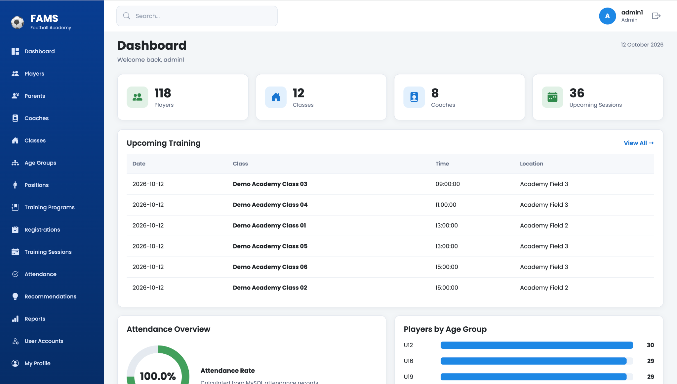
DASHBOARD
12 · USER INTERFACE
Academy overview and upcoming sessions.
Totals for players, classes, coaches and sessions, the next training sessions, and the attendance rate.
Notes:
Dashboard: academy overview and upcoming sessions, with totals, upcoming training and the attendance rate calculated from MySQL attendance records.

Slide 18
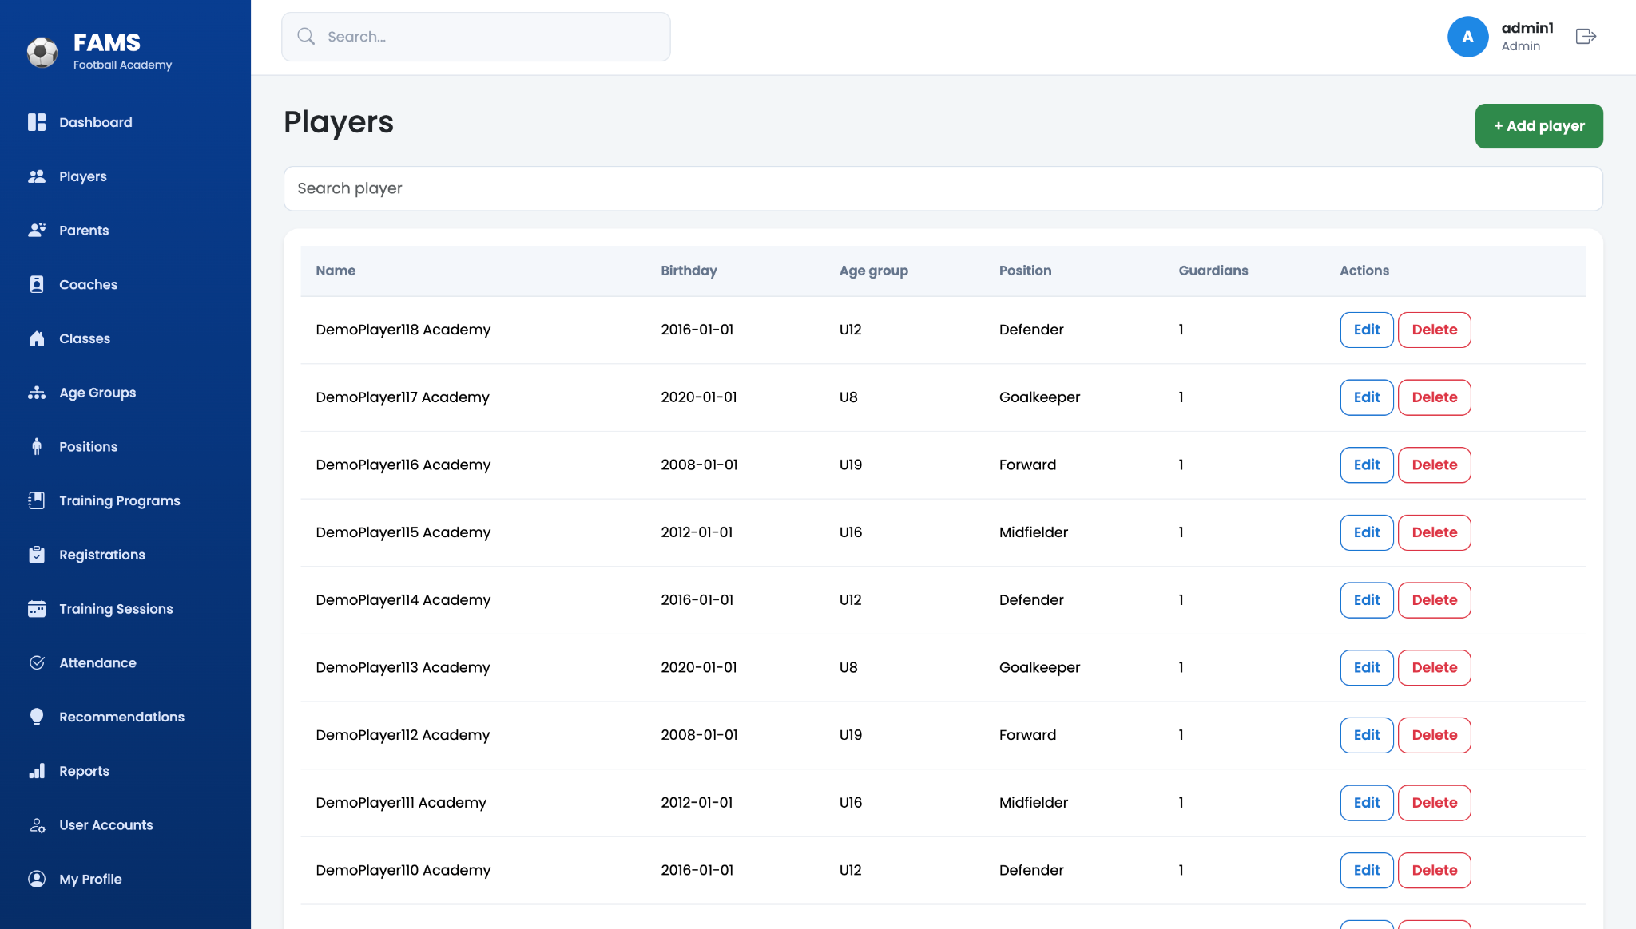
PLAYERS
12 · USER INTERFACE
Search and manage player records.
Each row shows age group and position, with edit and delete actions. A new player needs at least one guardian.
Notes:
Players: search and manage player records. When a new player is created the application requires at least one guardian.

Slide 19
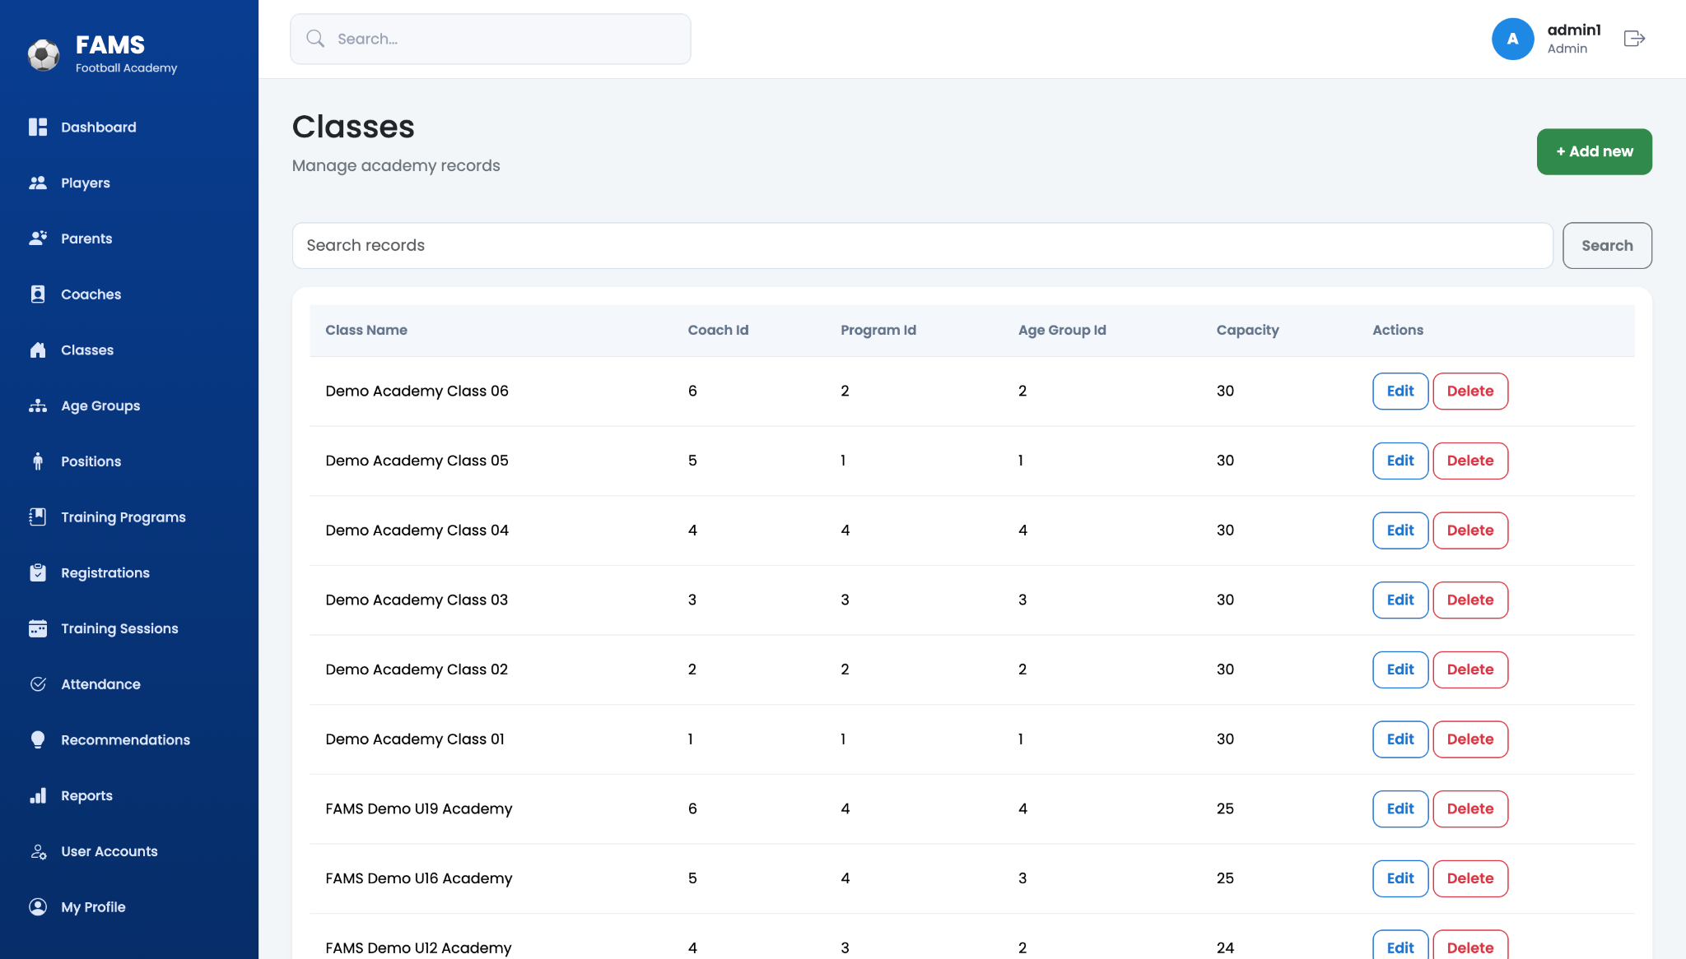
CLASSES
12 · USER INTERFACE
Manage classes, coaches and capacities.
Every class has one coach, one program and one age group, plus a capacity that registrations cannot exceed.
Notes:
Classes: manage classes, coaches and capacities. Business rules 2, 7 and 8 and the capacity check apply here.

Slide 20
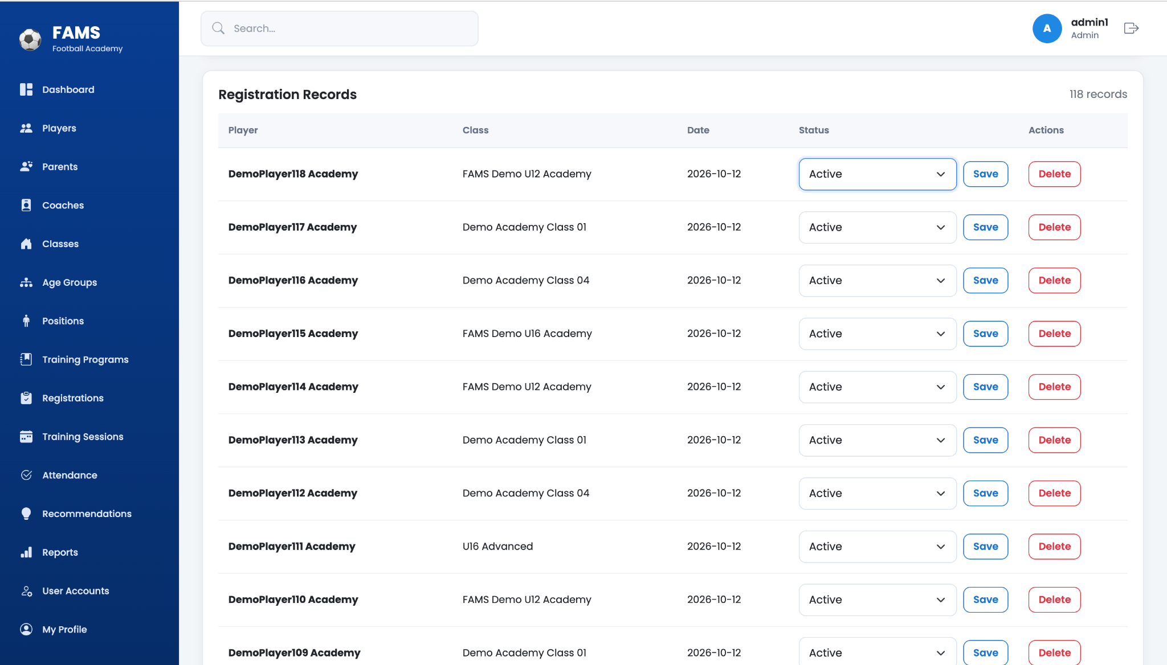
REGISTRATIONS
12 · USER INTERFACE
View and update player enrollments.
Status is Active, Pending, Cancelled or Completed. A full class rejects another active registration.
Notes:
Registrations: view and update player enrollments. Changing a status to Active re-checks the class capacity inside a transaction that locks the class row.

Slide 21
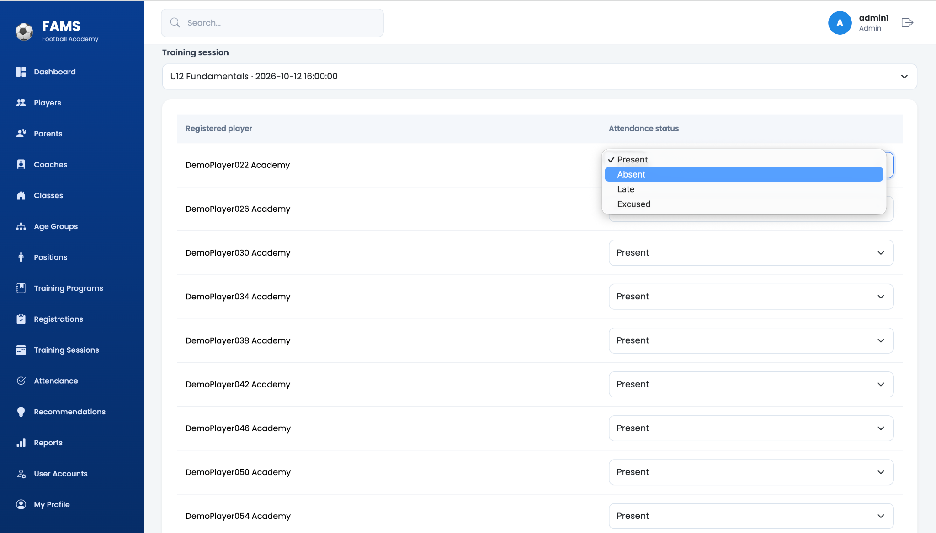
ATTENDANCE
12 · USER INTERFACE
Record training-session attendance.
Choose a session, then mark each registered player Present, Absent, Late or Excused.
Notes:
Attendance: record training-session attendance. The database allows one record per player per session and only for players registered in the session's class.

Slide 22
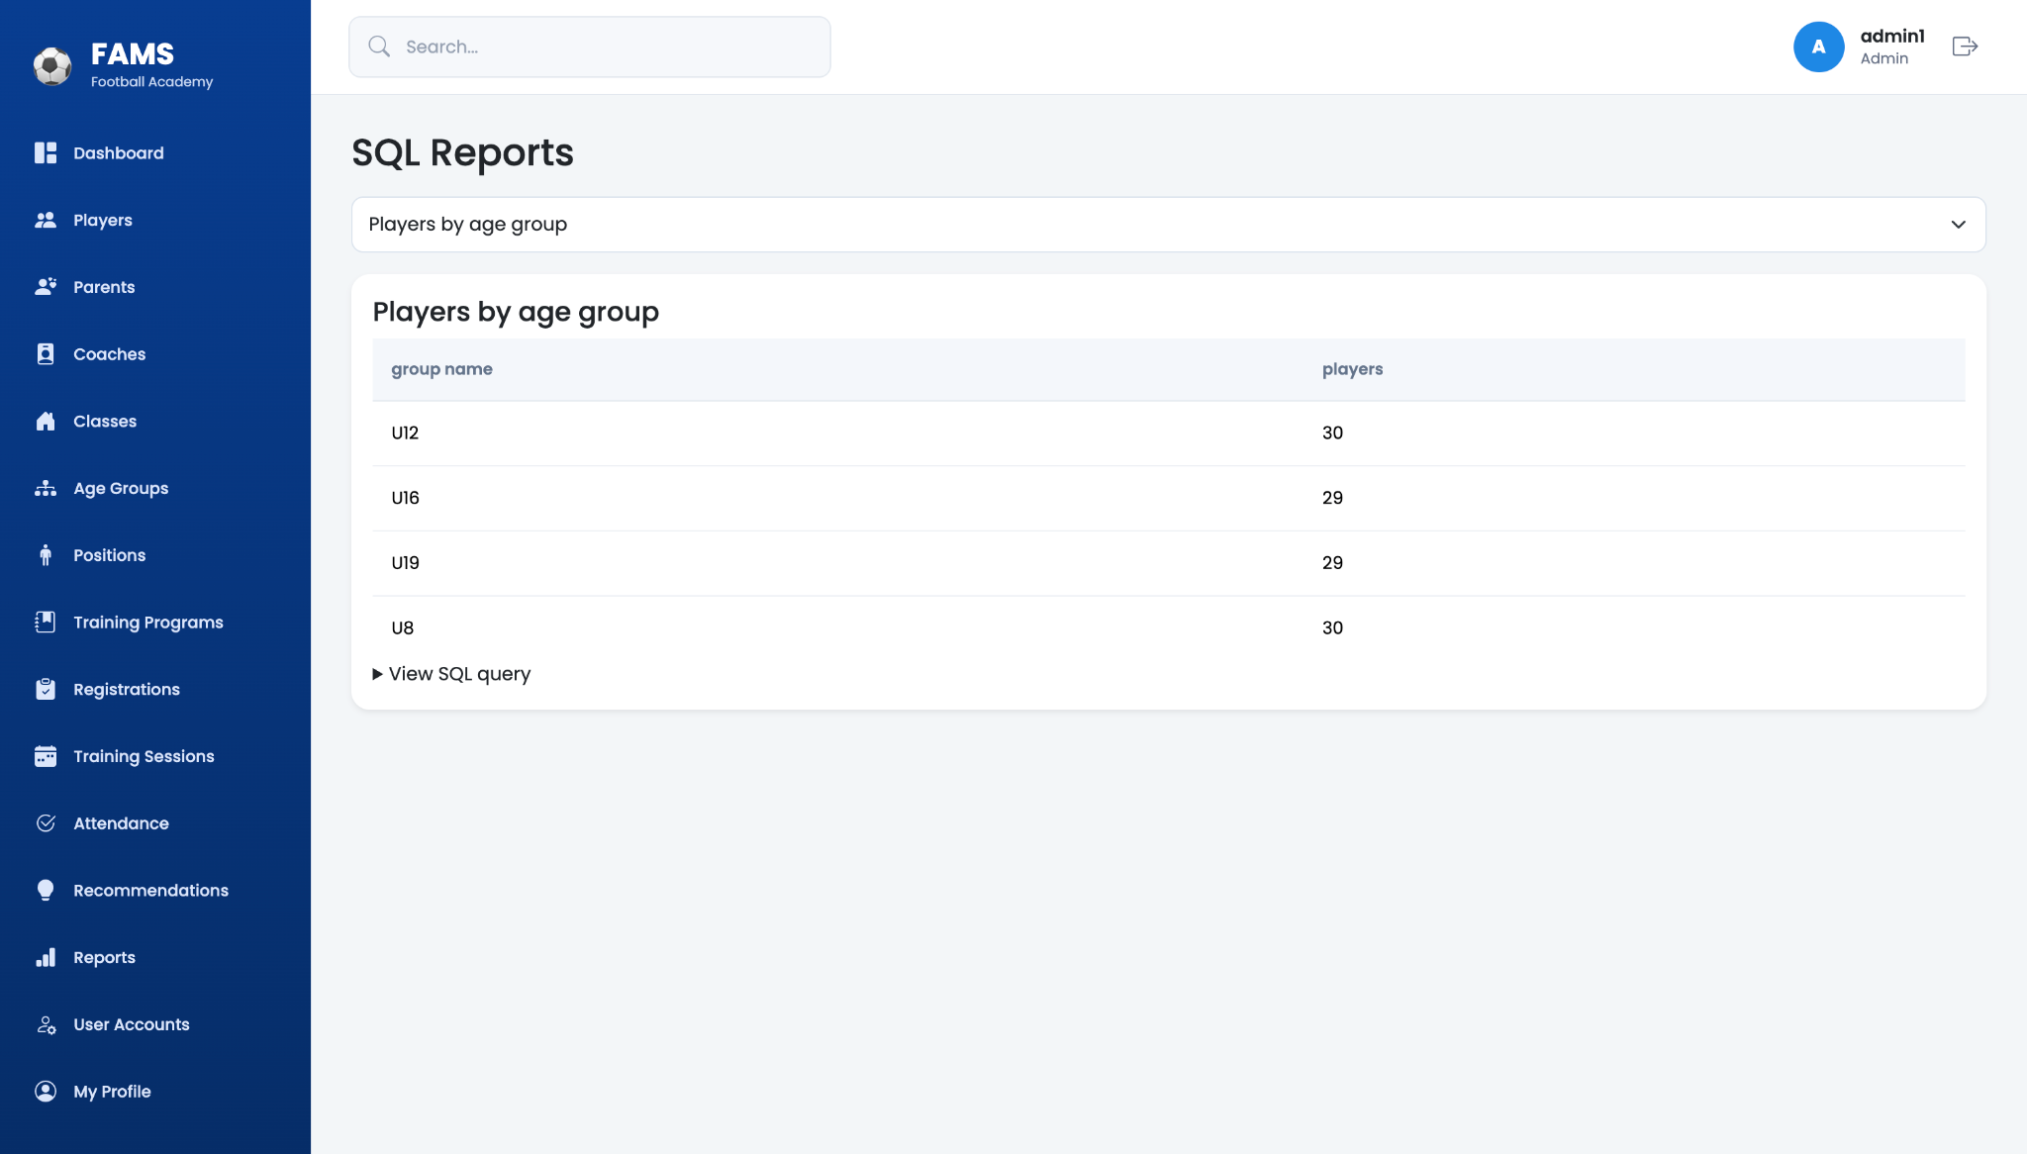
SQL REPORTS
12 · USER INTERFACE
View SQL results by age group.
Pick a report from the list and see the query result, for example players per age group.
Notes:
SQL reports: management reports run as plain SQL; the page shows the result for the selected report, here players by age group.

Slide 23
QUESTIONS?
THANK YOU
Source code: github.com/JakPz/Database-Project-Second_Year-
Noppajit Jadsorn · 682115020
Jakkaphat Didsabanjong · 682115008
Notes:
Open for questions. Demo accounts exist for the four roles (see scripts/seed-demo-accounts.js). Replace the placeholder with the GitHub repository link before presenting.

